Slide 1

Neural Networks in Traffic Data
Scott Houston

Slide 2
Summary
Introduction
Questions to Answer
Summary of Data
Possible Covariates
Choosing Covariates
Reduction from Covariance
Reduction from Significance
Types of Models
Full Models
Reduced Models
Balanced Model
Grid Search
Questions Answered
Conclusions

Slide 3
Introduction
There are hundreds of thousands of car accidents across the United States every year. These result in fatalities, property damage, and traffic jams. While civil engineers and city planners can't eliminate the possibility of a car accident, they are tasked with alleviating as many of these situations as possible through the design of our roads. They help create clear guides on roadways, plan common detours in the case of an accident, and monitor traffic data to improve overall traffic flow.
This helps to alleviate confusion as citizens commute to work each day or travel to see family. In an effort to minimize these accidents, data analysis is critical.

Slide 4
Questions to Answer
Are road conditions a significant factor in traffic accident severity?
What are the significant impacts of different road environmental features?
How accurately can we predict the severity of the accidents given a variety of situations?

Slide 5
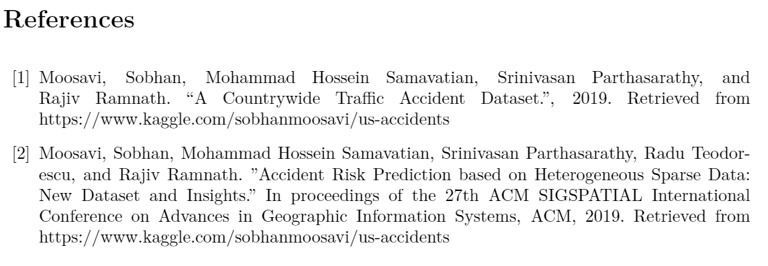
Data Set
I collected traffic data from kaggle.com; the data originally came from Mapquest and Bing. Both companies offer access to their live maps for drivers. This data set condensed the known accidents into different groups based on the severity of the accident.
The variables were almost all binary, dummy variables, related to the situation. For example, if the accident happened at an intersection, or if there was a traffic light. Other variables were recorded from the date/time of the accident and the weather conditions.
The personal information about the drivers, such as age, sex, etc., wasn't included in the set. This limited the number of ways I could evaluate it.

Slide 6
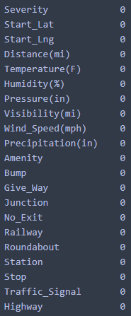
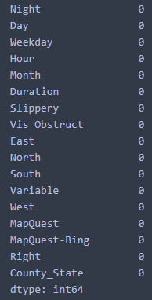
Possible Covariates

Slide 7
Deciding of Covariates
Two Approaches to Limiting the Covariates
Reduce based on Covariance
Reduce based on Linear Regression significance

Slide 8
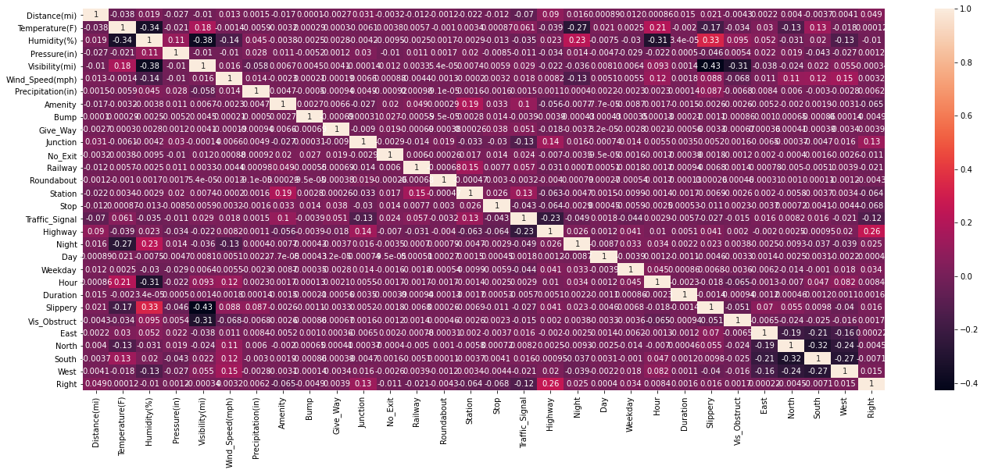
Covariance Matrix

Slide 9
Linear Regression Significance
Full Model
Dep. Variable: Severity
R-squared (uncentered): 0.955
Adj. R-squared (uncentered): 0.955
F-statistic: 2.304e+06
Prob (F-statistic): 0.00
Log-Likelihood: -2.6388e+06
No. Observations: 3513617
AIC: 5.278e+06
BIC: 5.278e+06
Df Model: 32
Reduced Model
Dep. Variable: Severity
R-squared (uncentered): 0.951
Adj. R-squared (uncentered): 0.951
F-statistic: 1.025e+06
Prob (F-statistic): 0.00
Log-Likelihood: -1.1094e+06
No. Observations: 1435573
AIC: 2.219e+06
BIC: 2.219e+06
Df Model: 27
Same Factors were considered NOT Significant
Month, No_Exit, Variable are NOT considered significant

Slide 10
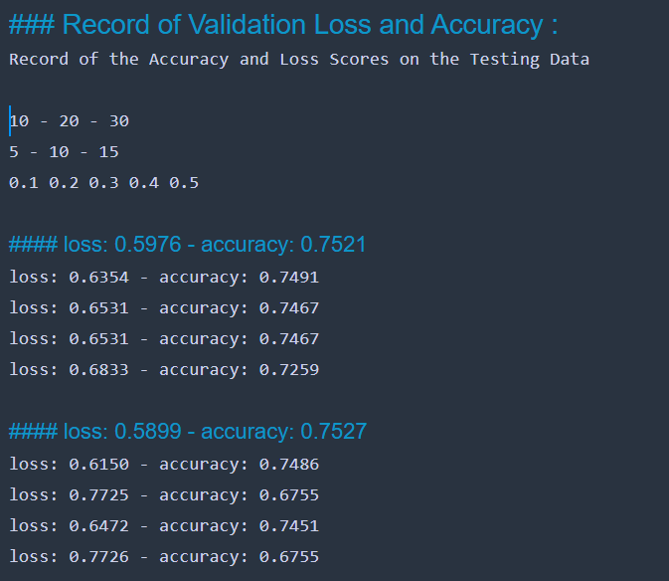
Grid Search for Hyper-Parameters

Slide 11
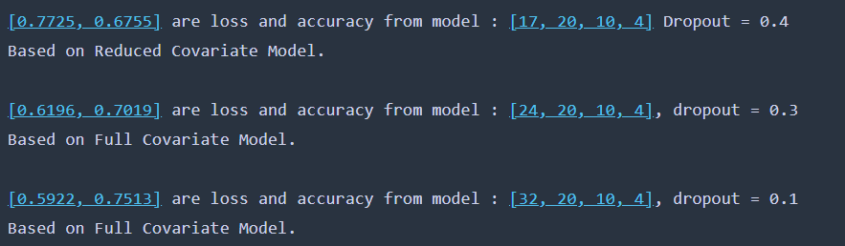
Grid Search for Hyper-Parameters
Results of different NN Models
Overall there wasn’t a significant change in the way that the different hyper-parameters affected the model accuracy.
All values for accuracy were roughly 75%

Slide 12
Modeling Approaches
Full Model – NA values are filled means
Reduced Model – NA rows are omitted
Scaling Model – Non-categorical columns are scaled
Balanced Model – Balance the ratio of response variables

Slide 13
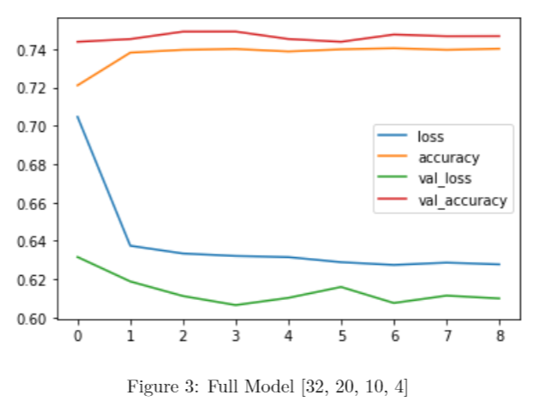
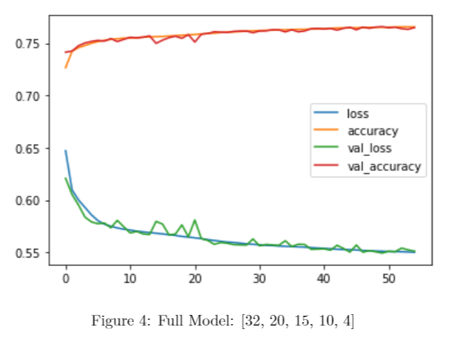
Full Model :

Slide 14
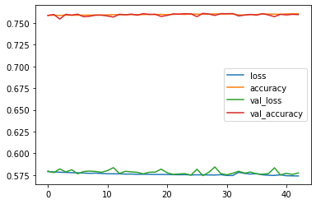
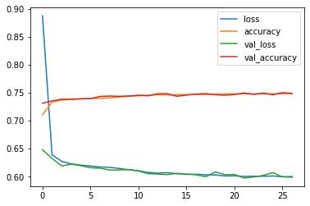
Reduced Model :
Reduced Model :
24–20–20–4
Reduced Model :
24–20–4

Slide 15
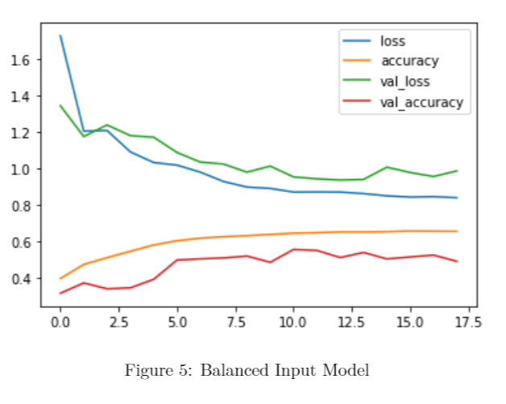
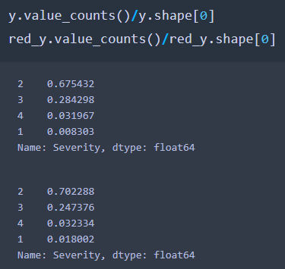
Balancing the Response Vector

Slide 16
Questions to Answer
Are road conditions a significant factor in traffic accident severity?
What are the significant impacts of different road environmental features?
How accurately can we predict the severity of the accidents given a variety of situations?

Slide 17
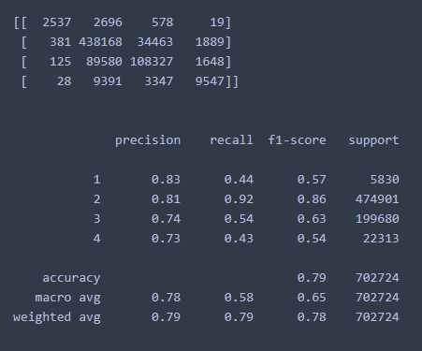
Comparison to Random Forest

Slide 18
Future Research
The main component I think is necessary is the information about the drivers themselves. As I continued my research using this data set. I determined that there is a lot of crucial information being lost by not taking the driver’s characteristics into account.

